Slide 1

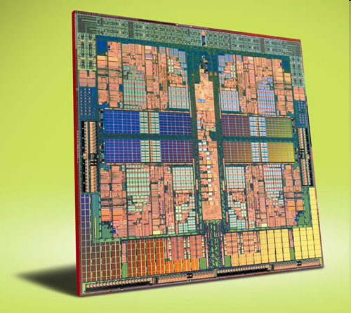
Multi-core processors

Slide 2
History
In the early 1970’s the first Microprocessor was developed by Intel.
It was a 4 bit machine that was named the 4004
The 4004 was followed by Intel’s 8008 and 8080, as well as motorola’s 6800 and 68000

Slide 3
Growth
With each new generation of processors there were several developments such as:
Smaller size
Faster
Increased heat dissipation
Greater Consumption of power

Slide 4
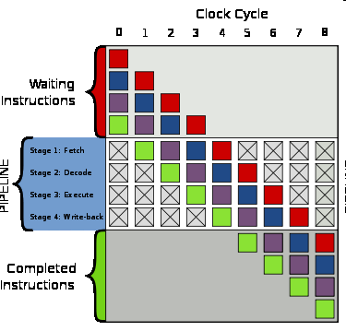
Single Core Performance
On technique used to increase single core performance was:
Pipelining: beginning other waiting instructions before the first finishes

Slide 5
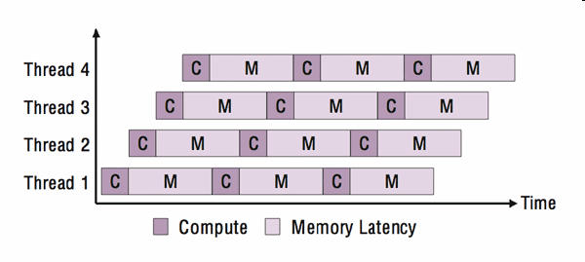
Single Core continued
Another technique was multithreading
Multithreading involves execution of two separate threads.
Time is divided and interlaced between the two threads in order to simulate simultaneous execution

Slide 6
Problems with Single Core
To execute the tasks faster you must increase the clock time.
Increasing clock times too high drastically increases power consumption and heat dissipation to extremely high levels, making the processor inefficient.

Slide 7
Multi Core solution
Creating two cores or more on the same Die increases processing power while keeping clock speeds at an efficient level.
A processor with 2 cores running at efficient clock speeds can process instructions with similar speed to a single core processor running at twice the clock speed, yet the dual core processor would still consume less energy.

Slide 8
Multi-Core Advantages
While working with many threads, a Multi Core processor with n cores can execute n threads simultaneously by assigning a core to each thread. If it must process more than n threads , say x, it can apply multithreading procedures with each core working with an average of x/n threads.
A Single core processor must multithread with every single thread.

Slide 9

Other Incentives
Improving an existing single core design or creating a better one is problematic in that it:
Is time consuming to design
Is risky to modify existing designs
Creating multi core processors is convenient in that:
The name “core dual” and similar names are good for marketing.
It has lower manufacturing costs.
Uses proven processor designs.

Slide 10
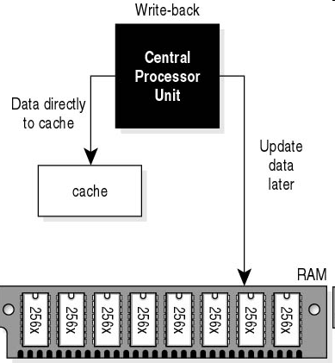
Implementations
Two main ways to have multiple cores interact are the shared memory model, and the distributed memory model.
In the shared memory model,
all cores share the same cache
memory.
In the distributed memory model,
each core has its own cache
memory.

Slide 11
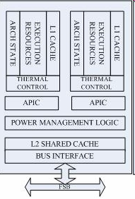
Implementations continued
The Intel core duo design
has a separate L1 cache
memory for each core, but
both cores share an L2
cache.

Slide 12
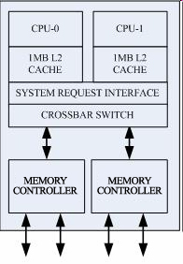
Implementations continued
The AMD Athlon 64 X2
implementation has
separate L1 and L2
cache memory for each
core.

Slide 13
Problems
Some of the current problems found with multi core processors include:
Memory/Cache coherence. As mentioned earlier, some implementations have distributed L1 caches but must share an L2 cache. This poses the problem of making sure each core keeps the other updated with changes in the data in its own cache.

Slide 14
Problems continued
Multi threading is also a problem when the software being run is not designed to take advantage of the multi core processor. This may mean that one core does most of the work which means that the processor is running no more efficiently than a single core.

Slide 15
Future of Multi Core
Current debates argue over whether future multi core processors should be homogenous or heterogenous.
That is, should all the cores be the same or should there be a mix of different types?

Slide 16
Future continued
Having all cores be the same makes production easier and keeps its complexity to a minimum.
Having different cores that are specialized in specific tasks increases complexity but has the potential to be much more efficient in speed and power consumption.

Slide 17
References
http://www.intel.com/multi-core/
http://www.faqs.org/patents/app/20090055826
http://www.csa.com/discoveryguides/multicore/review2.php?SID=s0s5lp3hcg6fa6pf2ba28u84d0

